Slide 1
Q Learning Implement
人工智慧與機器學習5/27
授課老師：陳以錚 教授
ADML LAB

Slide 2
CONTENTS
Concept
Environment
Training
Agent

Slide 3
1
01.
Concept
4
Environment
Training
Agent
小例子

Slide 4
02.
Environment
2
Init
Build
Reset
Reward
Update
4

Slide 5
3
03.
Training
4
Init Q(s,a) random
Repeat (for each episode)
Init s
Repeat (every steps in every episode)
choose a using policy derived from Q (epsilon)
take action a , observe r, s’
update Q = Q + alpha( r + gamma(Max Q’) - Q)
until t is terminal

Slide 6
04.
4
Agent
Traditional Q-Table
Deep Q Network
4

Slide 7
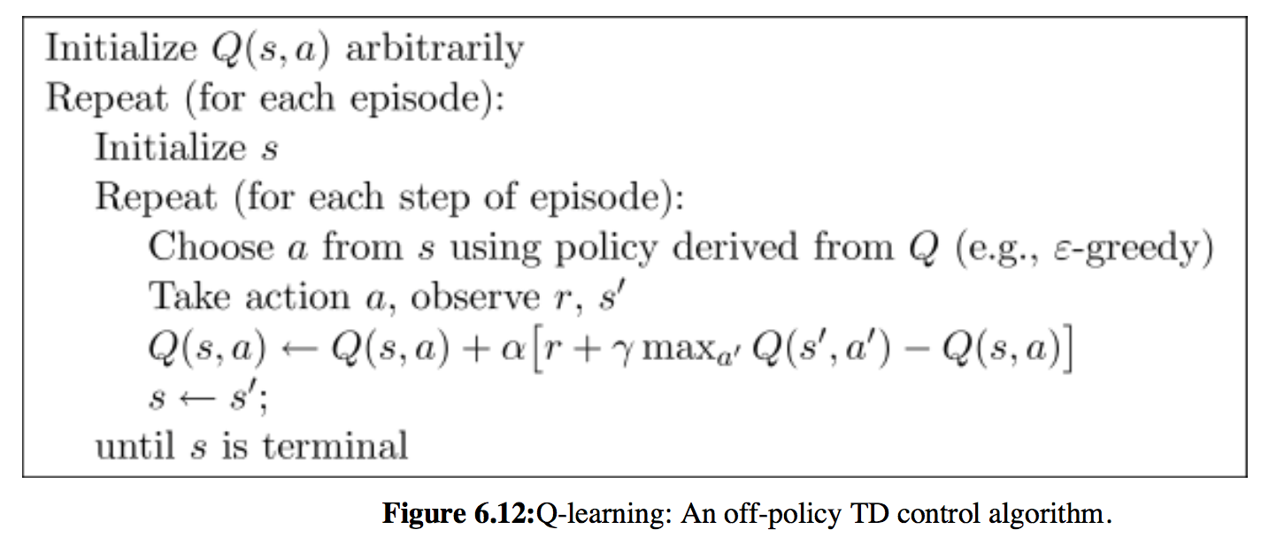
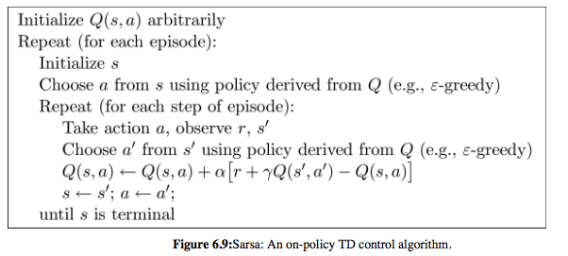
Homework
What is Sarsa?
Similar to Q-Learning
output a specific action
an on-policy learning method.

Slide 8
THANKS

